Slide 1
MCC data spatial clustering and deconvolution
3/23

Slide 2
Neighbor structure for clustering
For any given capture location (orange), we have up to 8 neighboring capture locations (blue) if we use L₁ distance

Slide 3
Neighbor structure for deconvolution
Each capture location is split into 7 “cells”

Slide 4
Neighbor structure for deconvolution
For any given cell (orange), we have up to 6 neighboring capture locations (blue)

Slide 5
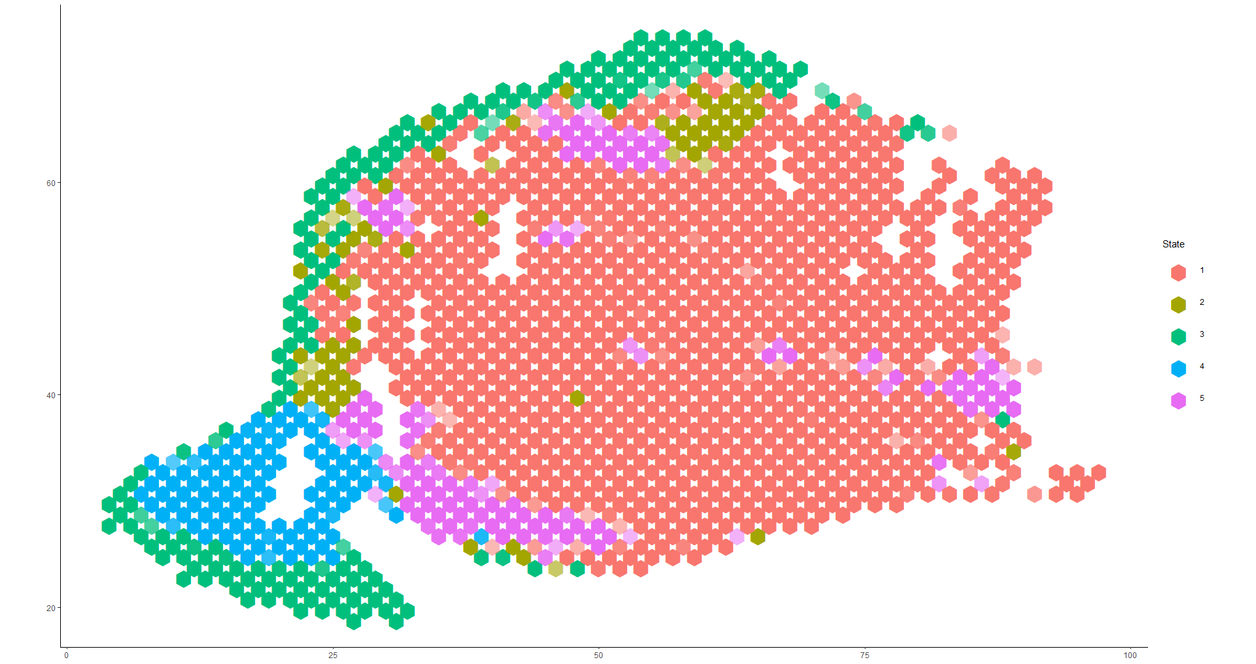
Clustering

Slide 6
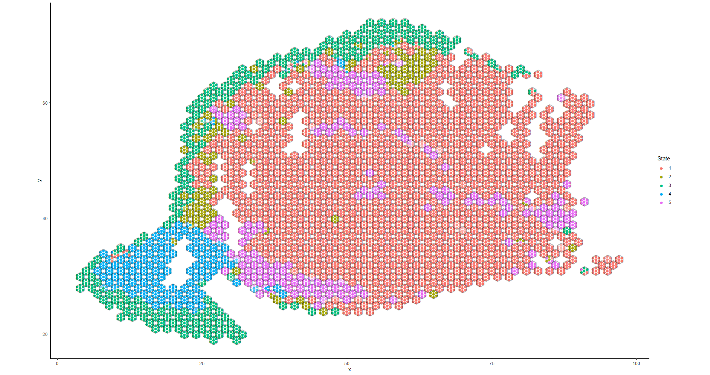
Deconvolution

Slide 7
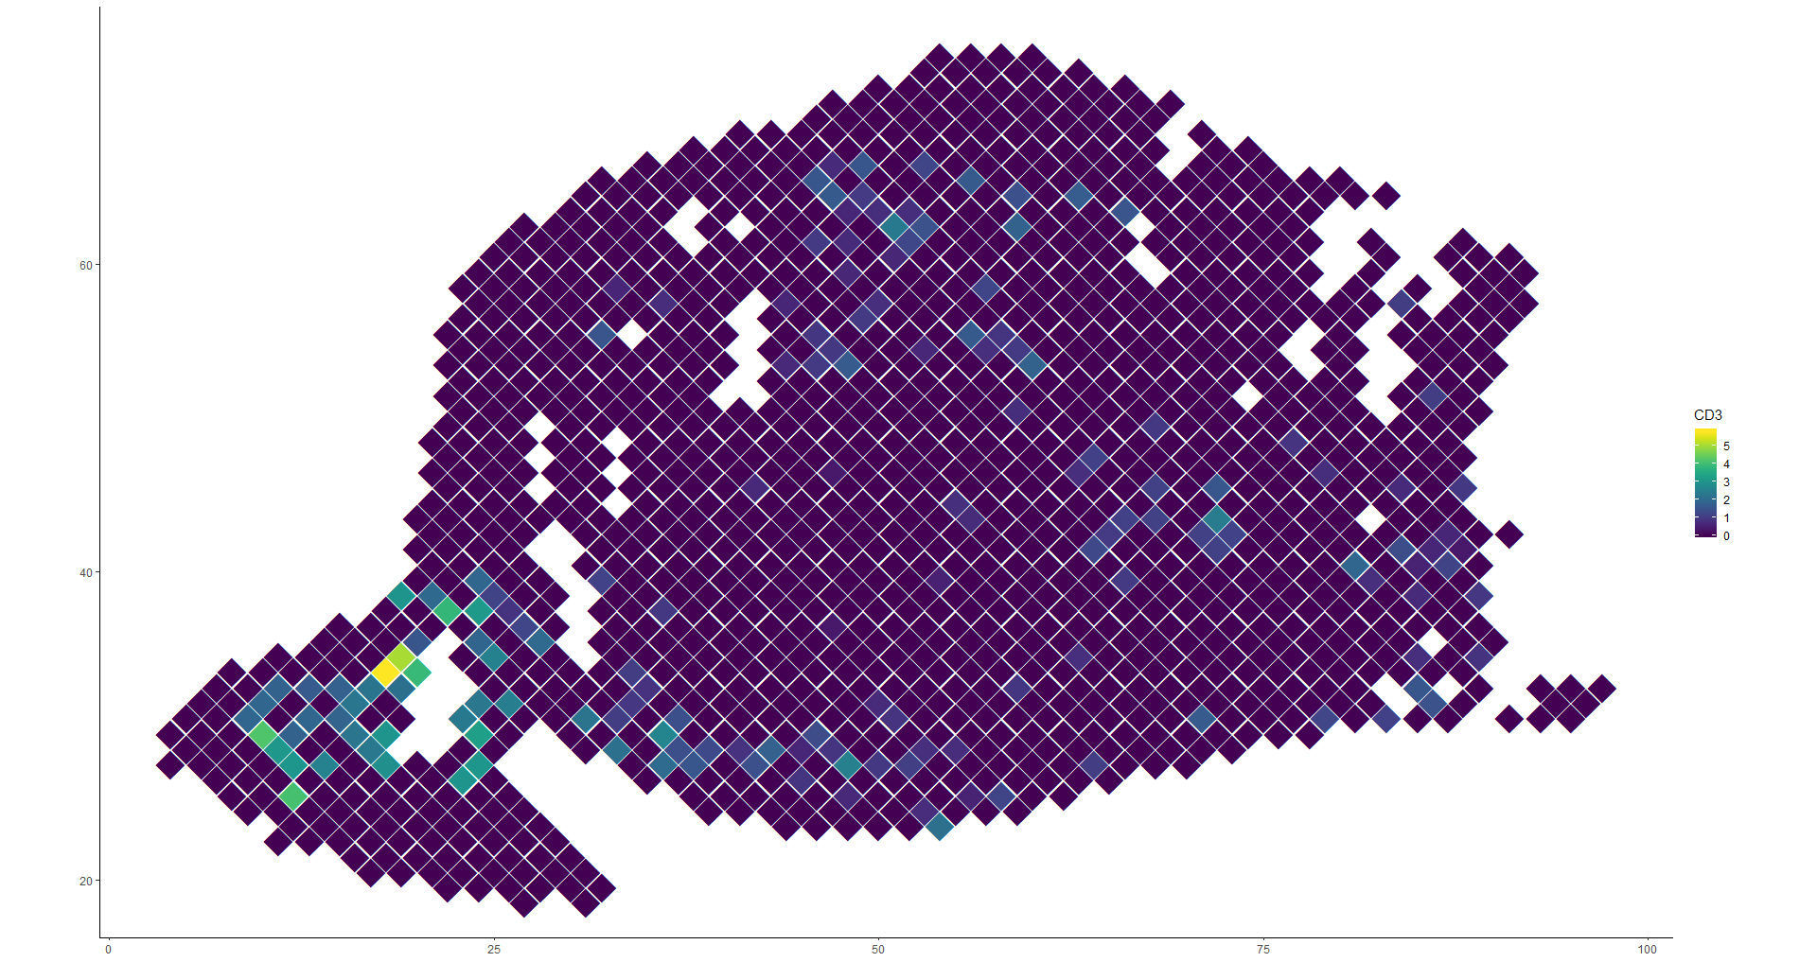
CD3 expression

Slide 8
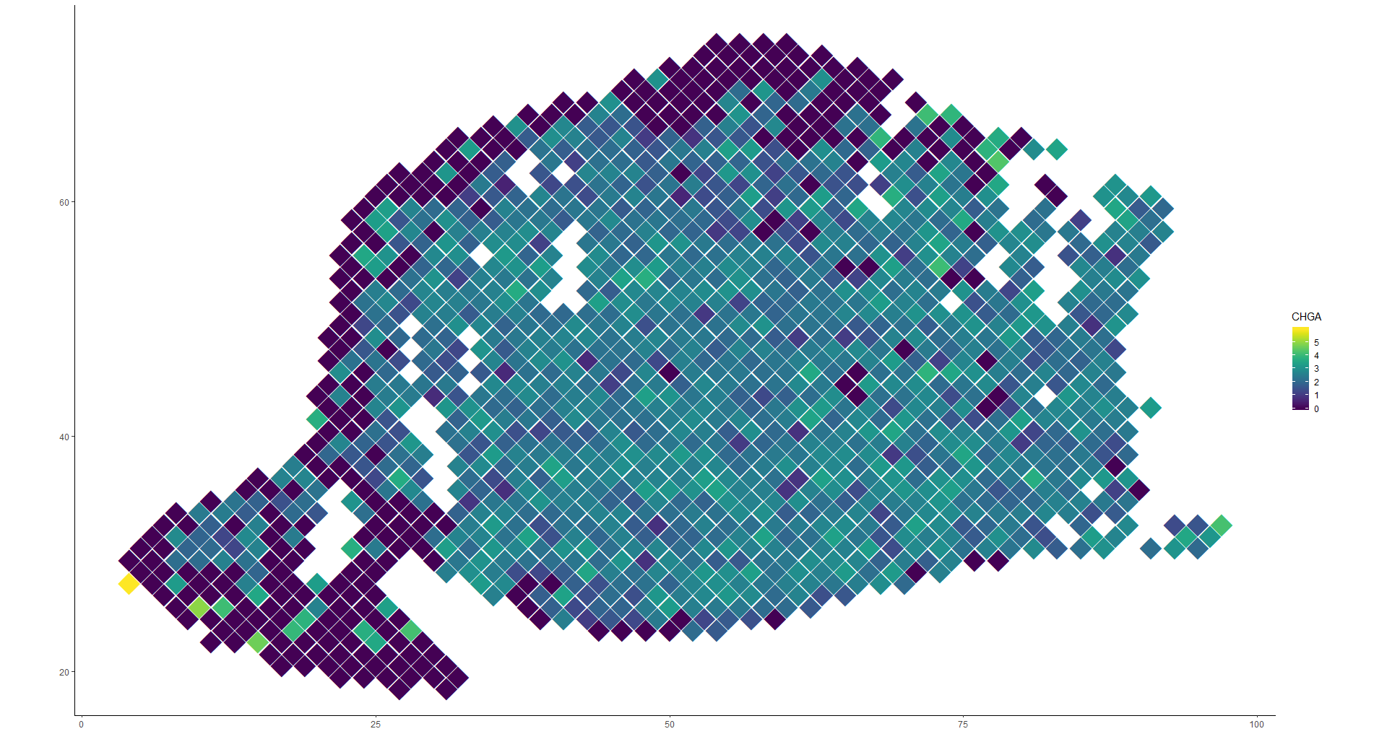
CHGA expression

Slide 9
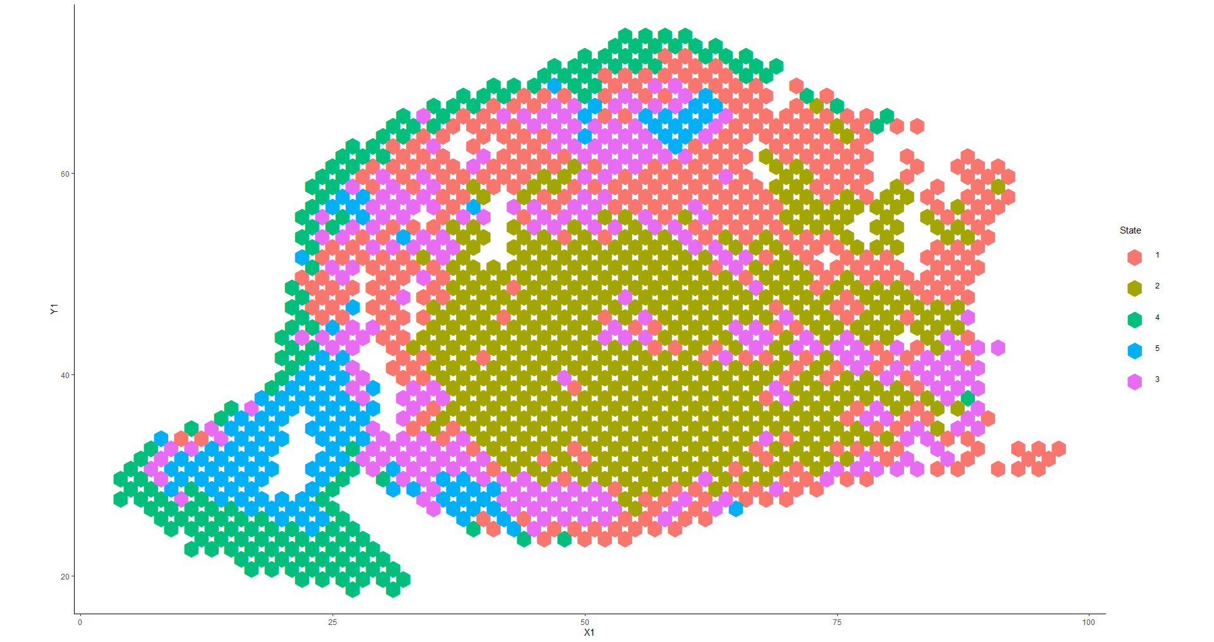
Nearest neighbors

Slide 10
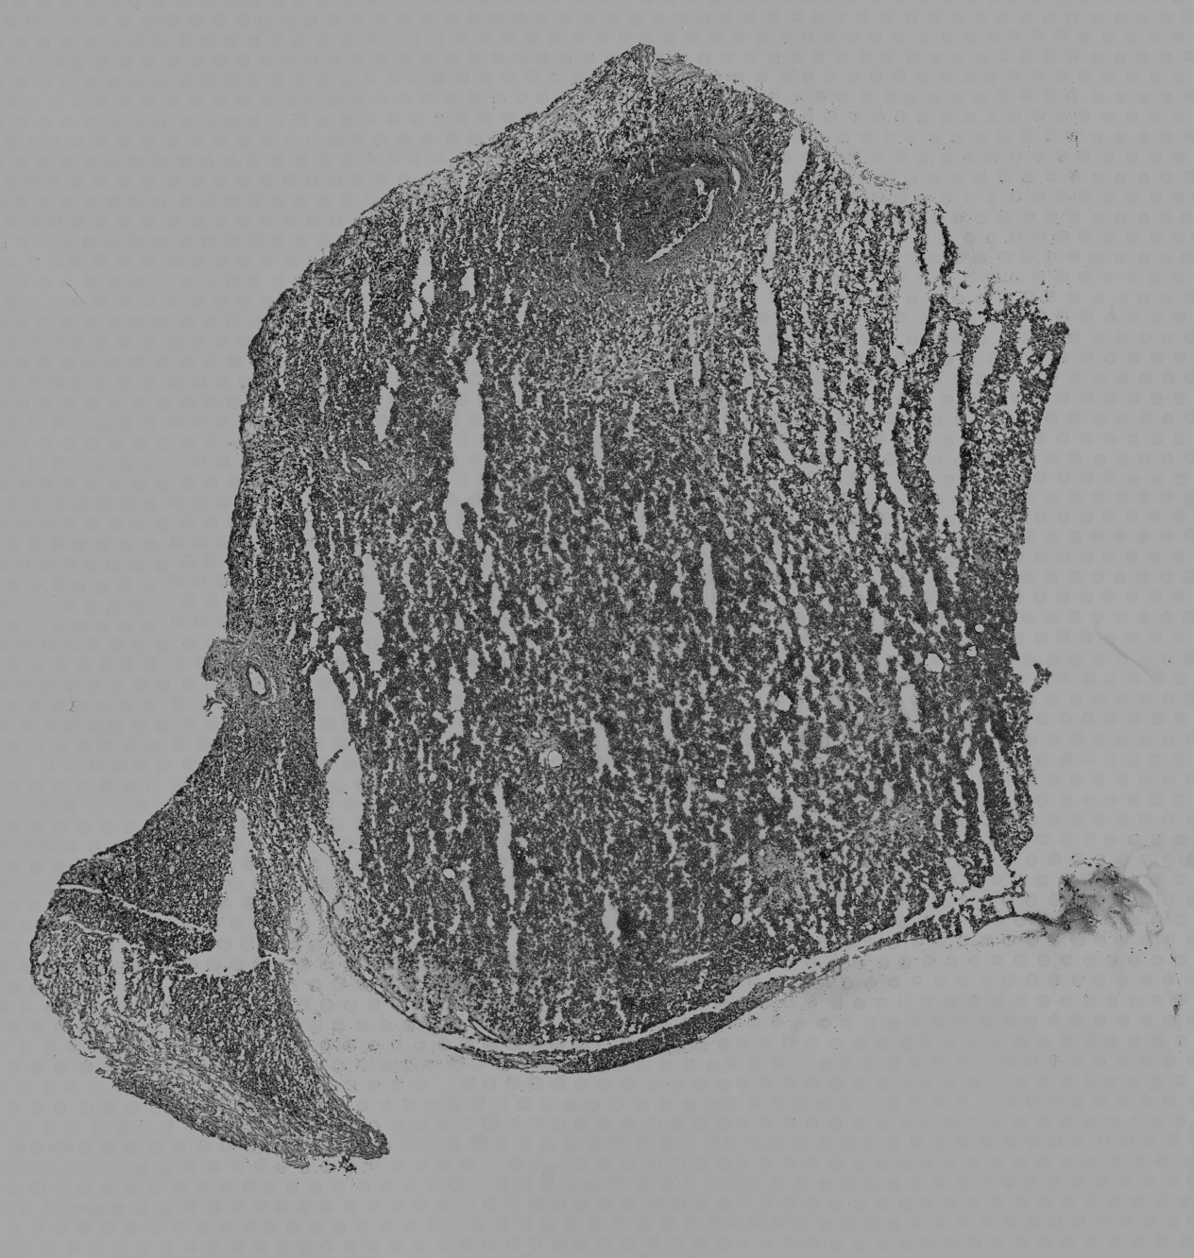
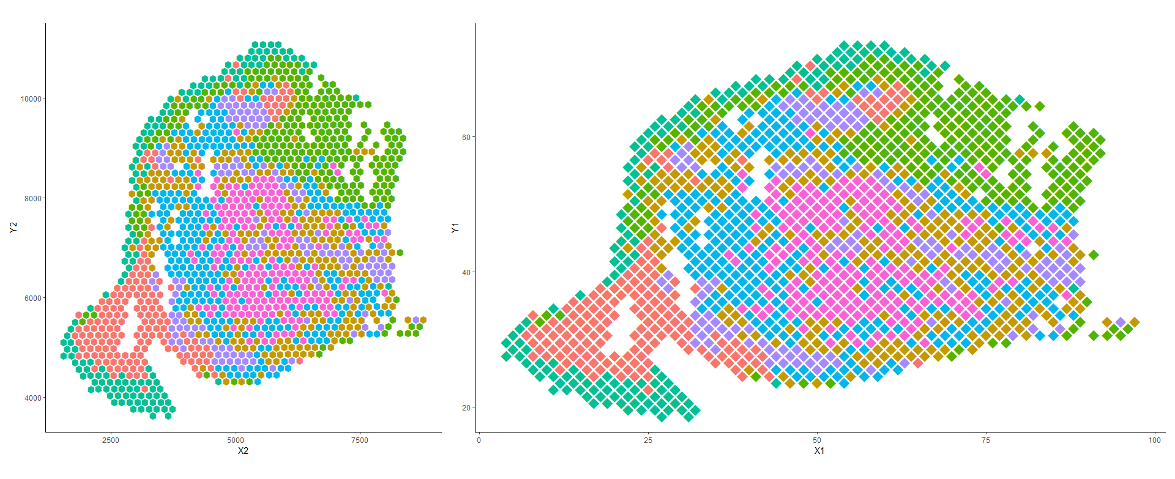
Coordinate scaling
1 X unit = 77.75 pixels
1 Y unit = 134.5 pixels

Slide 11
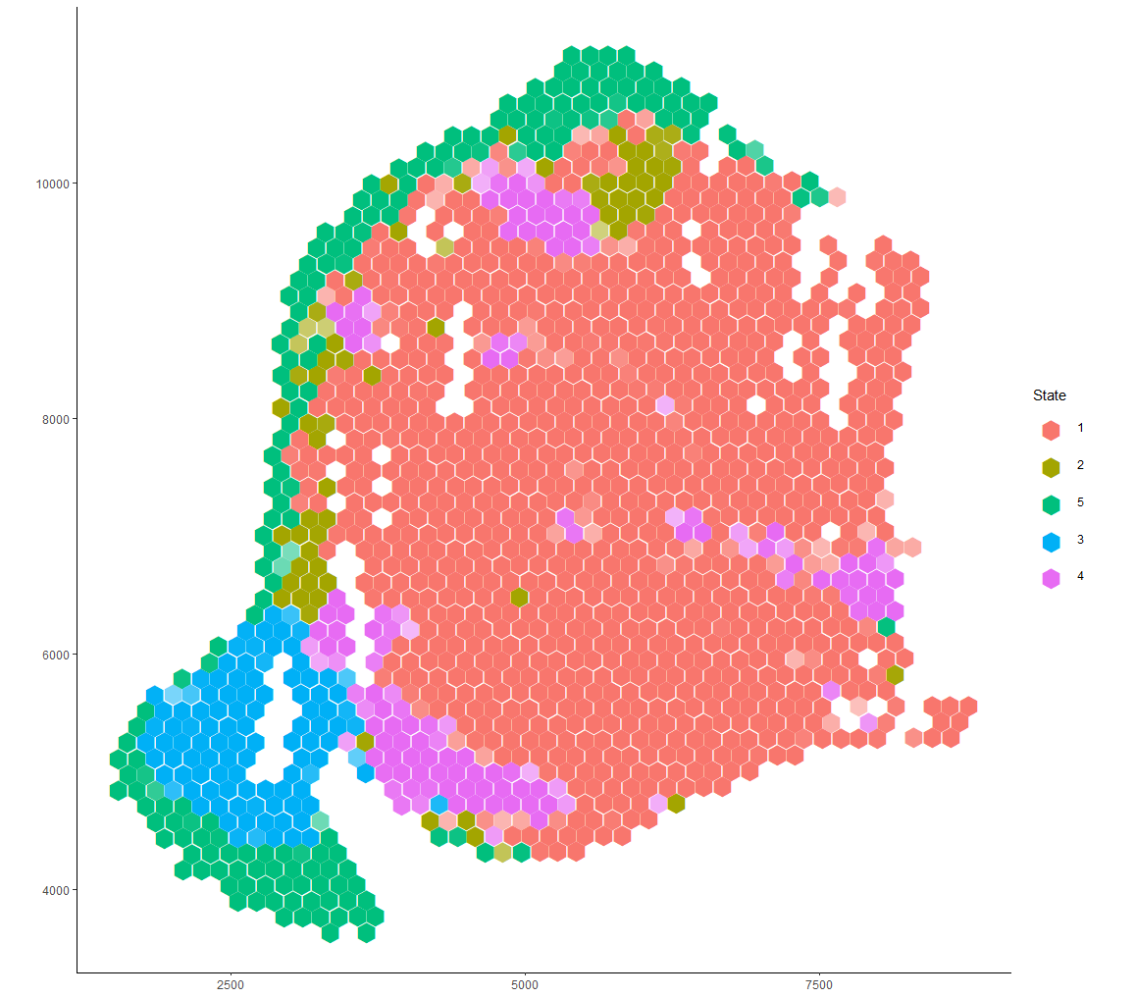
Clustering

Slide 12
Deconvolution neighbor structures

Slide 13
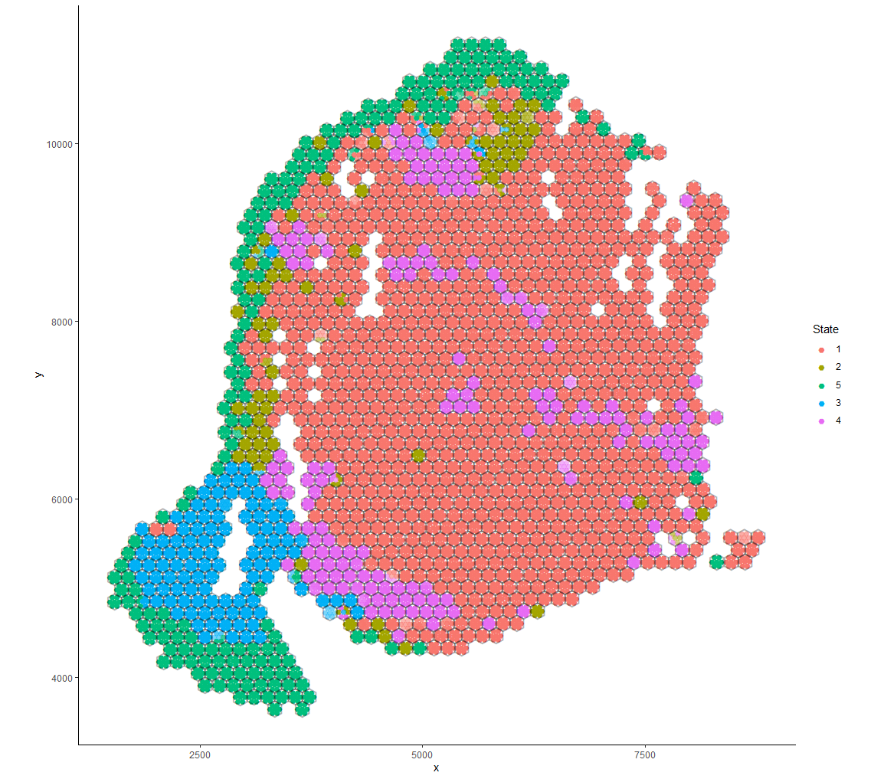
Deconvolution

Slide 14
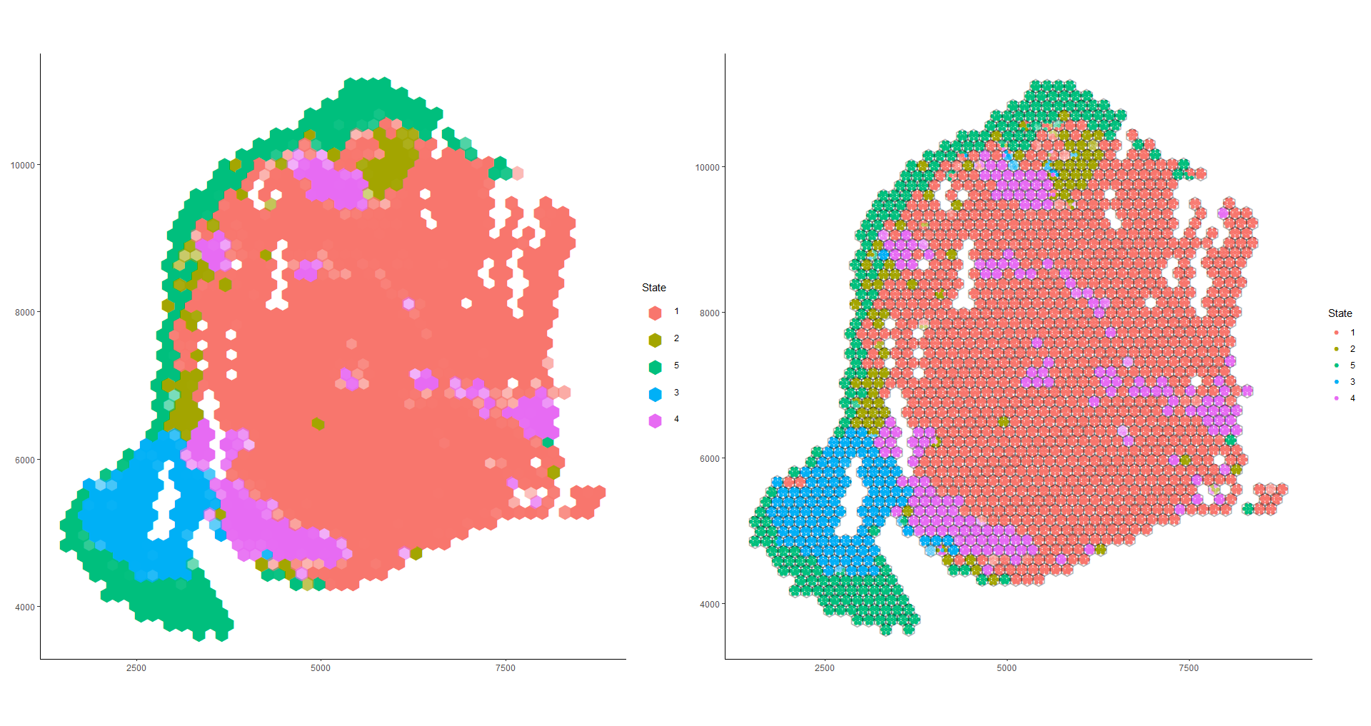
Clustering
Deconvolution

Slide 15
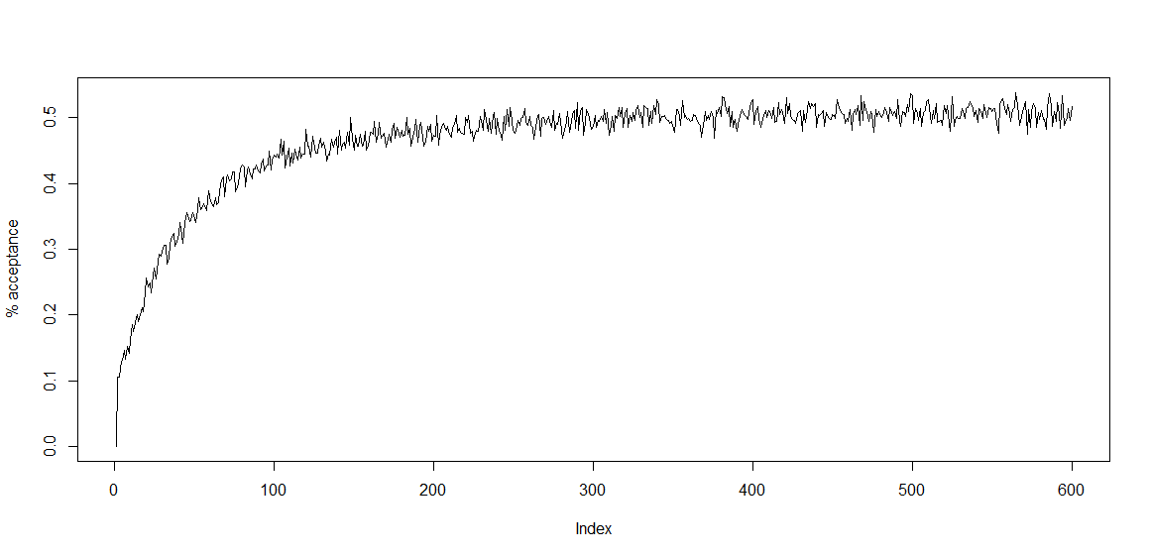
Acceptance probability with sigma = 1/50

Slide 16
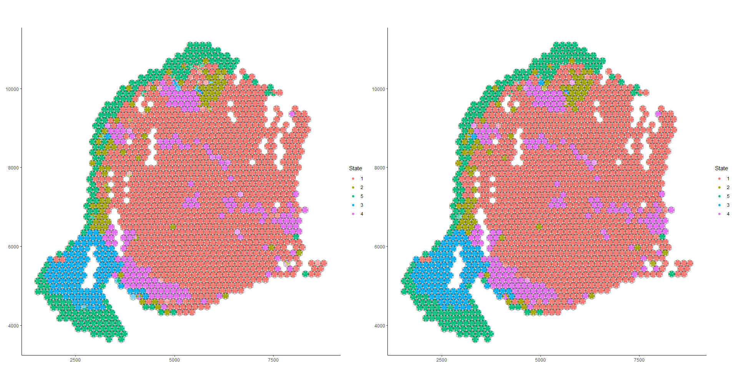
Sigma = 1/5
Sigma = 1/50 (preliminary)

